Slide 1


Speaker : Jian-Min Huang

Slide 2
Outline
Maven
What & Why
Quick View
More Detail
Do It Yourself
Other
Spring
IOC(DI) & AOP Concept

Slide 3
What Maven
Apache Maven is a software project management and comprehension tool. Based on the concept of a project object model (POM), Maven can manage a project's build, reporting and documentation from a central piece of information.

Slide 4
Why Maven
To solving library dependency hell problem
Comprehensive software develop and management tool
Popular in open source project and framework
Notes:
Show the pom.xml Dependency Hierarchy page
Project create, lib dependencies, clean, compile, test, package, deploy, reporting, documentation

Slide 5
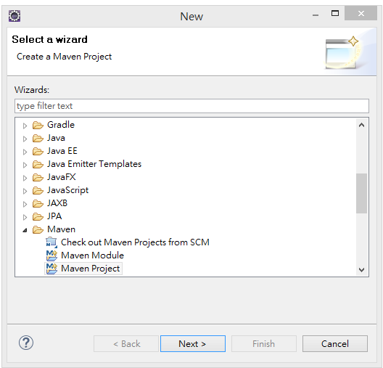
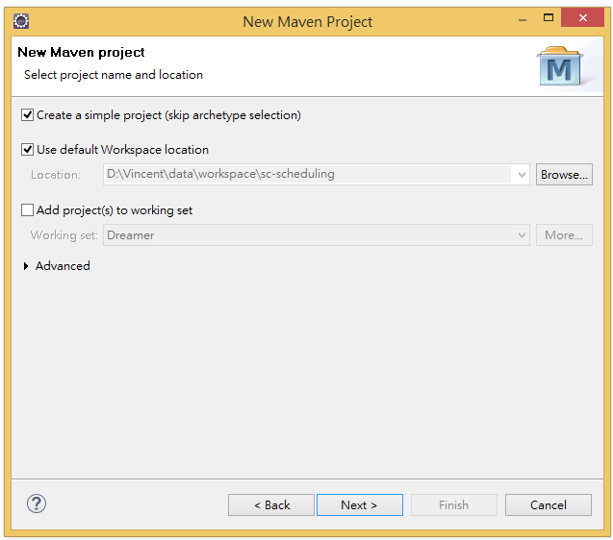
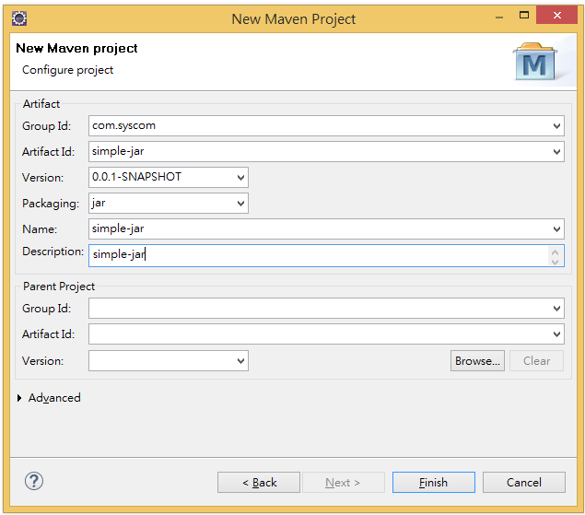
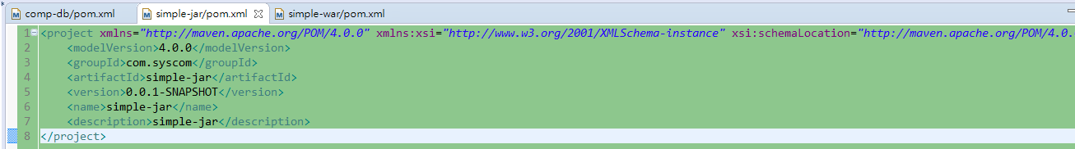
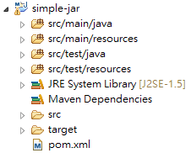
Simple Maven Project (jar)

Slide 6
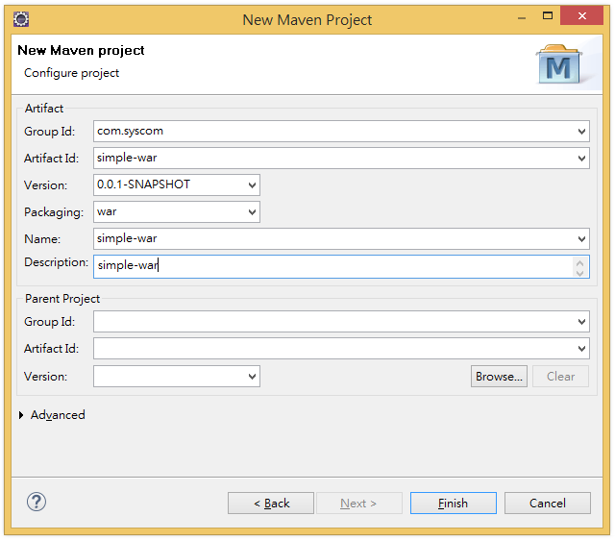
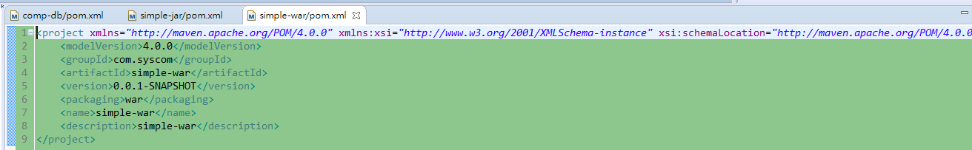
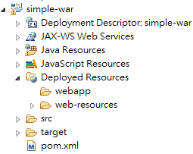
Simple Maven Project (war)
Notes:
demo my pom.xml

Slide 7
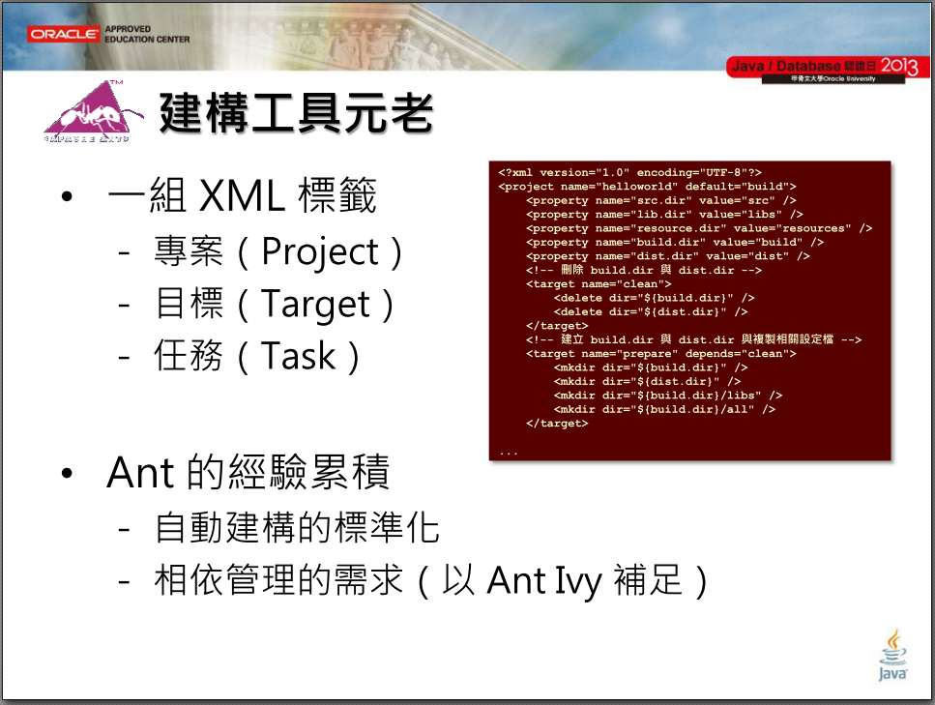
[1]
Notes:
build.xml
example in book

Slide 8
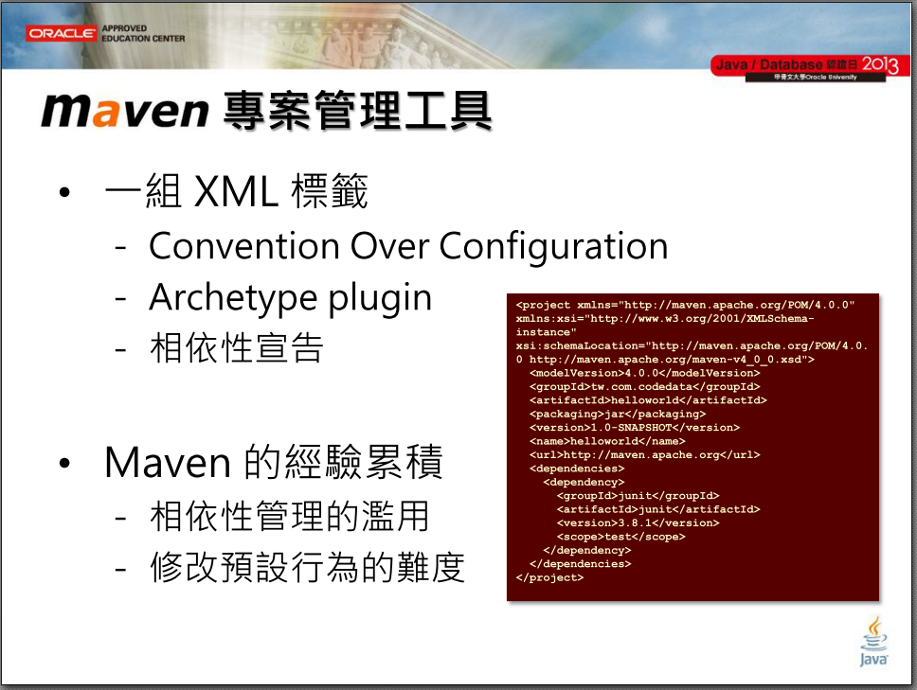
[2]
Notes:
steep learning curve

Slide 9
Compare to Ant
 | Ant | Maven
Create Project | Simple Java Project | Maven Project
Library | Put in Custom Directory, Add to Build Path | Add Dependencies to pom.xml
Custom Directory | Same | Same
Coding | Same | Same
Unit Test | Custom | In Lifecycle
Build | build.xml | pom.xml
Report | Custom | Maven Build
Document | Custom | Maven Build
Continuous Integration | Custom | Highly Support
Notes:
Show .m2 idea and version control difference
If we have sufficient time, then demo it

Slide 10
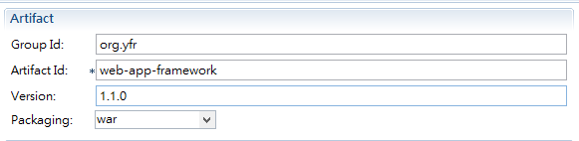
Maven Build – Coordinates

Slide 11
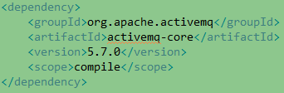
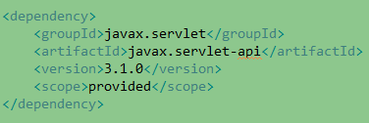
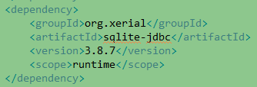
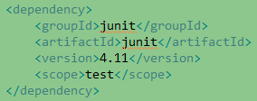
Maven Build – Dependency
[3]
Maven Central Repository

Slide 12
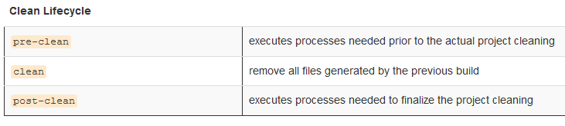
Maven Build – Life Cycle(1/3)
[3]

Slide 13
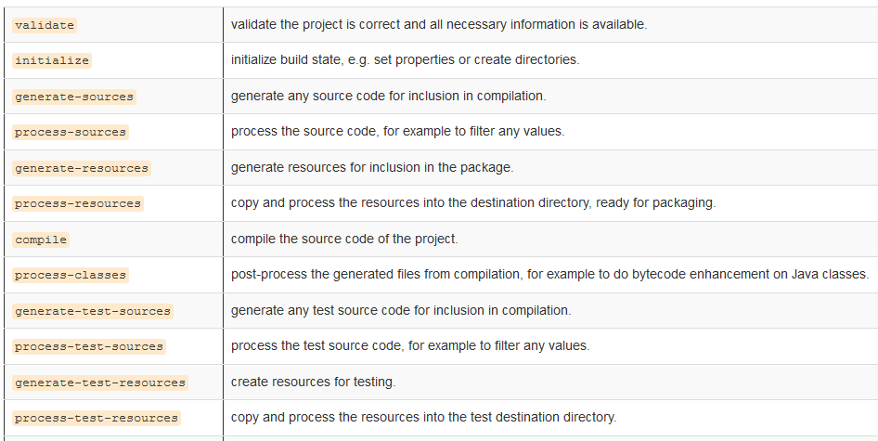
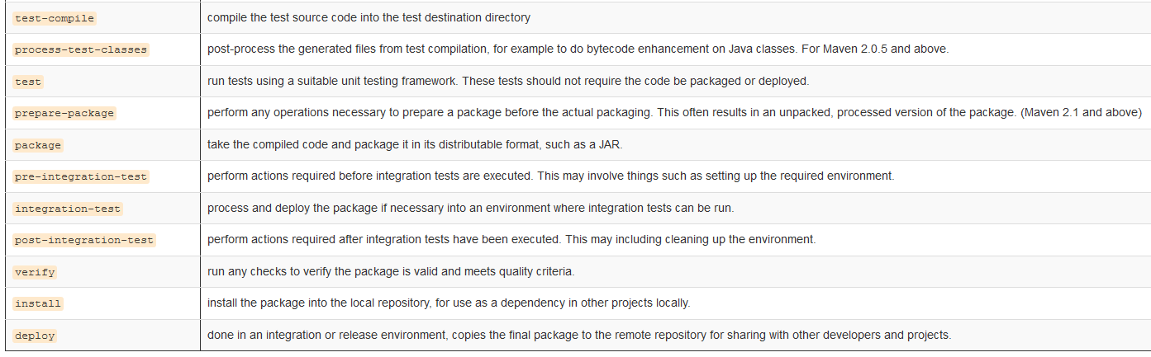
Maven Build – Life Cycle(2/3)
[4]

Slide 14
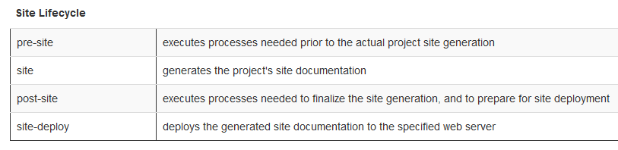
Maven Build – Life Cycle(3/3)
[5]

Slide 15
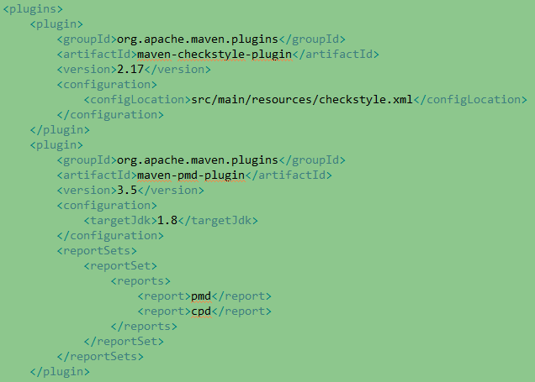
Maven Build – Reporting
Notes:
Show Maven Site

Slide 16
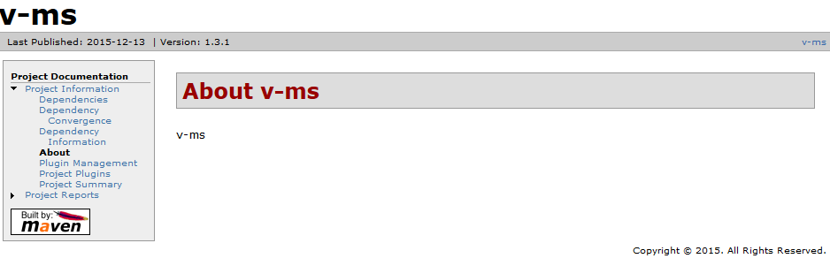
Maven Build – Documentation
[6]
Notes:
Show Maven Site

Slide 17
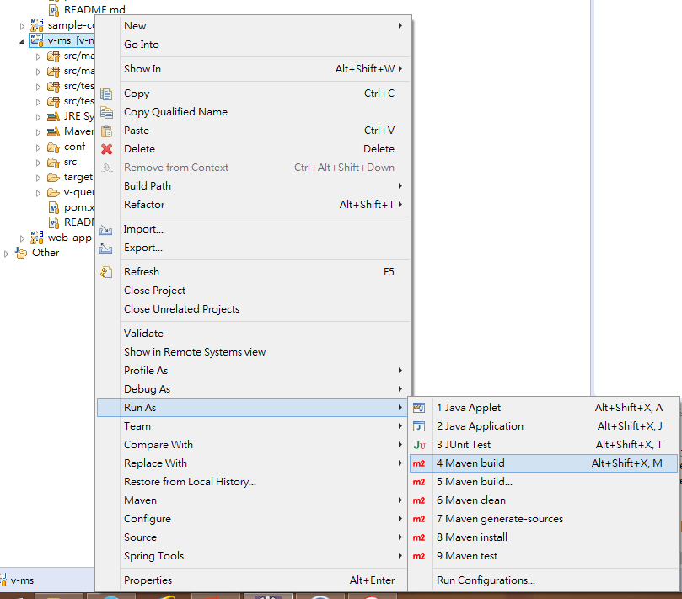
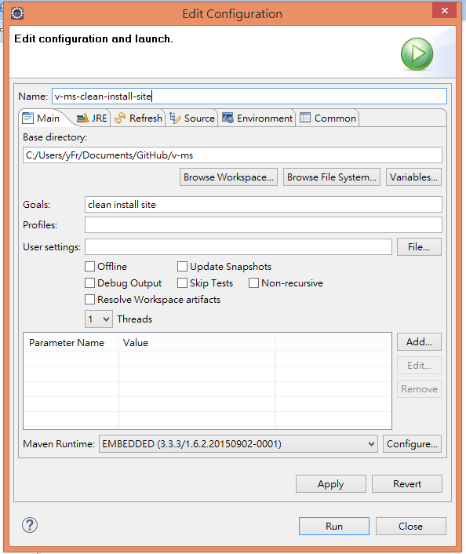
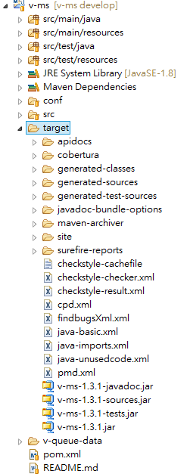
Maven Build – mvn clean install site
Notes:
Show Maven Site

Slide 18
Create Maven Project Demo
11

Slide 19
Future Works
Maven Parent And Children Project
Maven Private Repository (Nexus)
Join Continuous Integration (Jenkins)
Rich Maven Site & Document
Personal Archetype
Notes:
Show Nexus & Jenkins

Slide 20
Refencnce
林信良 淺談Groovy與Gradle page 23
林信良 淺談Groovy與Gradle page 24
https://maven.apache.org/guides/introduction/introduction-to-the-lifecycle.html
https://maven.apache.org/guides/introduction/introduction-to-the-lifecycle.html
https://maven.apache.org/guides/introduction/introduction-to-the-lifecycle.html
http://52.192.44.215:8080/jenkins/job/v-ms/site/index.html

Slide 21
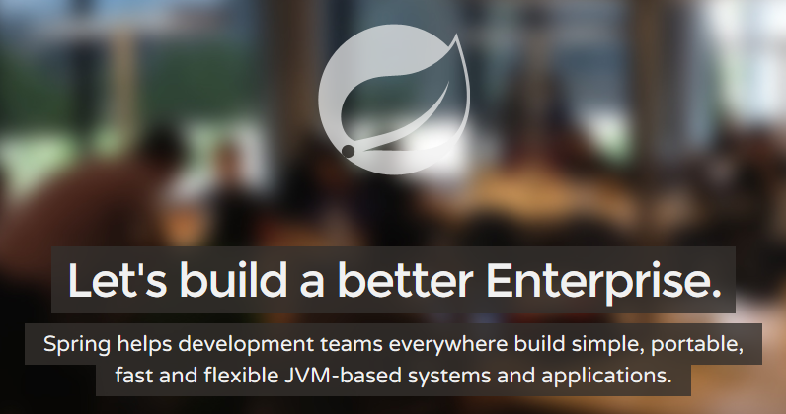

Speaker : Jian-Min Huang

Slide 22
Outline
Spring Framework
What & Why & How
Show Sample Code
Usage Scenarios
Do It Yourself
Other

Slide 23
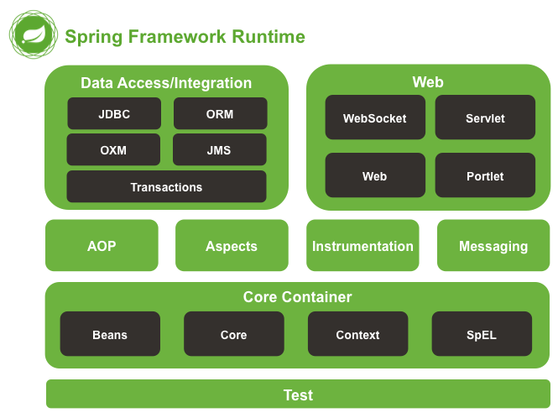
What Spring Framework
[7]
Notes:
Spring內容分兩大類，一類是概念實現(Core、AOP)，其他則許多是現行技術的封裝

Slide 24
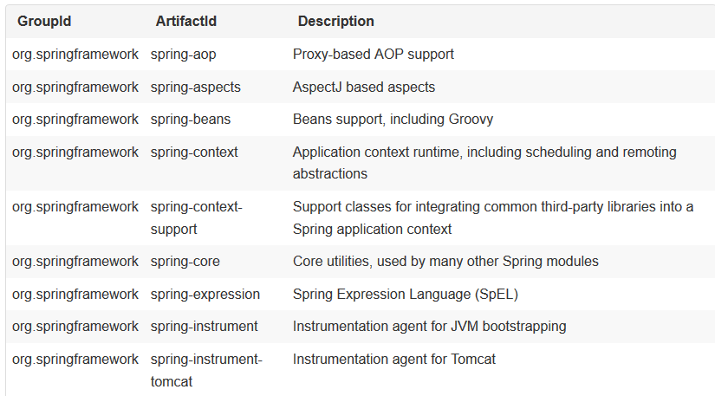
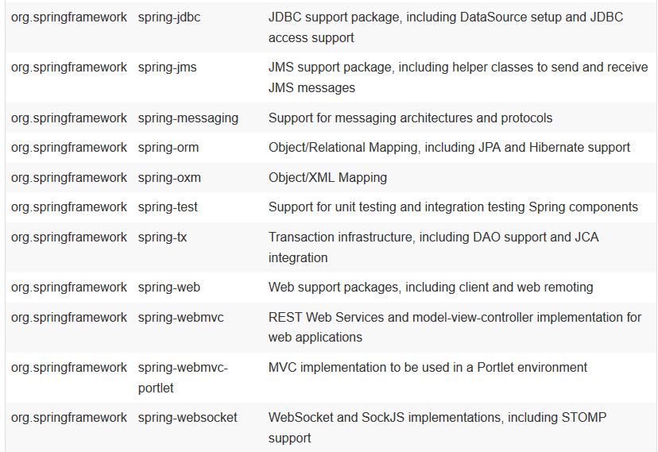
Spring Framework Artifacts
[8]
Notes:
show spring home http://spring.io/projects

Slide 25
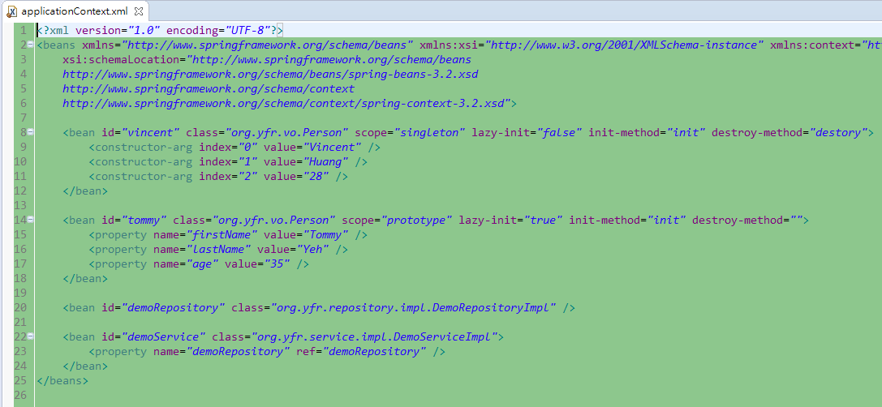
ApplicationContext.xml

Slide 26
Why Spring Framework
Base on Spring core, Spring helps development teams build simple, portable, fast and flexible JVM-based systems and applications.
Comprehensive software framework
Highly support Java related standard
Popular in open source community, update quickly
Notes:
http://www.oracle.com/technetwork/java/javaee/tech/index.html
https://github.com/spring-projects/spring-framework

Slide 27
How Spring Framework - Loosely Couple
Icon Means Object, Line Means Relation
Ignore Create Object And Garbage Collection
View
Common
Controller
Model
Repository

Slide 28
Inversion Of Control(Dependency Injection) Concept
View
Common
Controller
IOC Framework
Model
Repository

Slide 29
Aspect-Oriented Programming Concept
Request
View
Controller
Service1
Service2
Service3
Repository
Database
After Throw Exception
Before Service Method Call
After Service Method Call

Slide 30
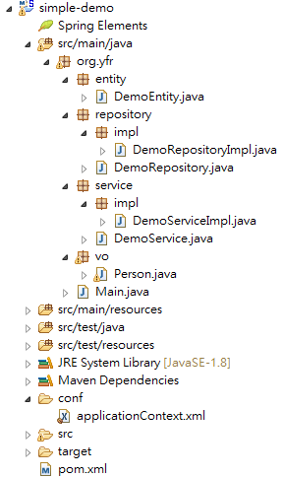
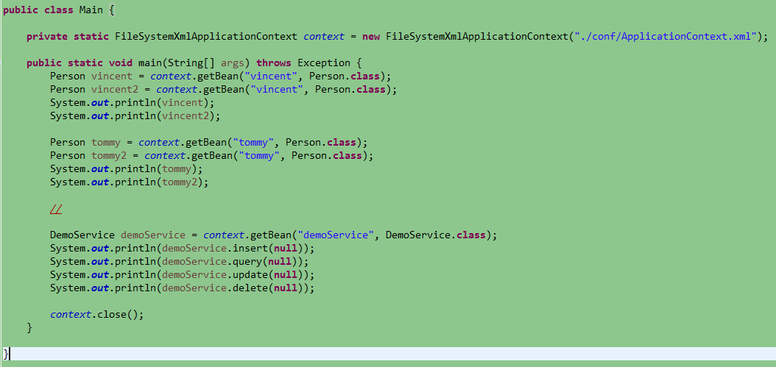
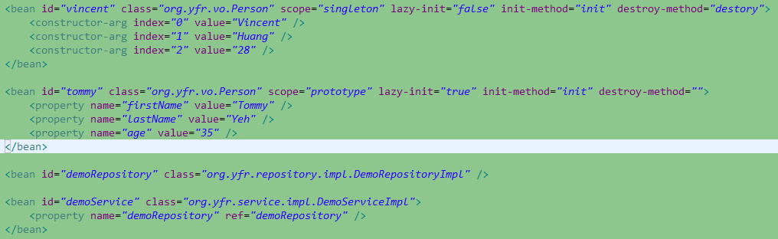
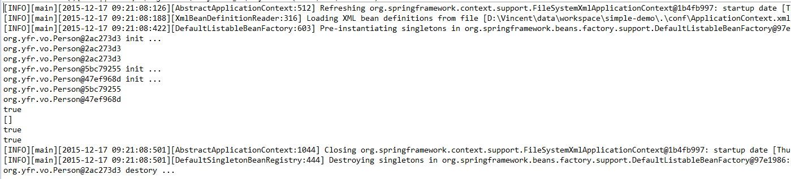
Spring Core
Notes:
show config & annotation

Slide 31
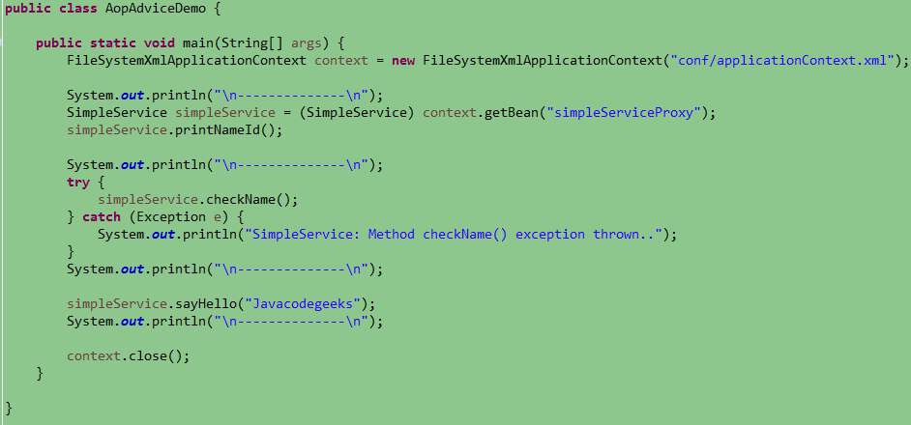
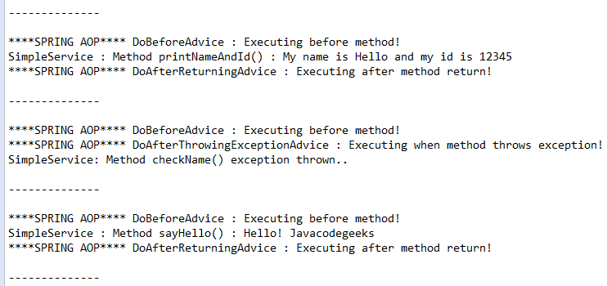
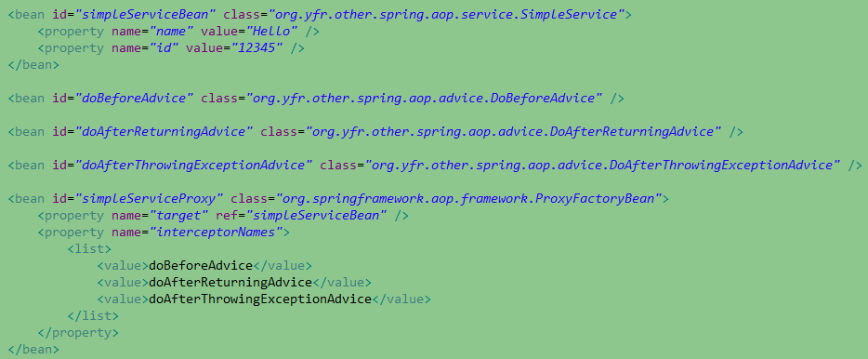
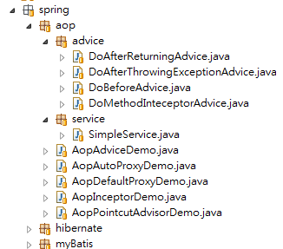
Spring AOP

Slide 32
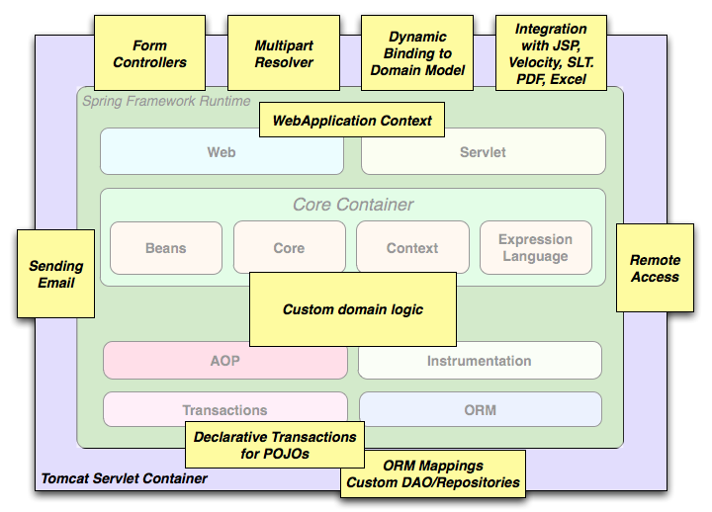
Usage Scenarios (1/3)
[9]

Slide 33
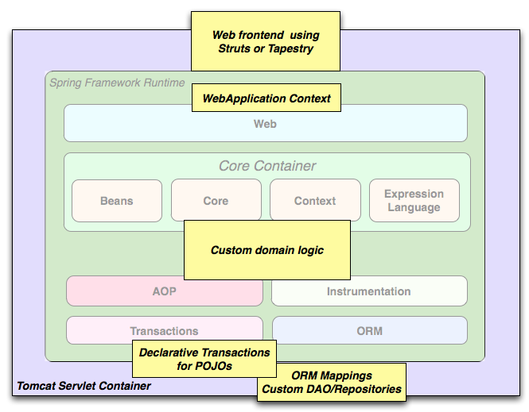
Usage Scenarios (2/3)
[10]

Slide 34
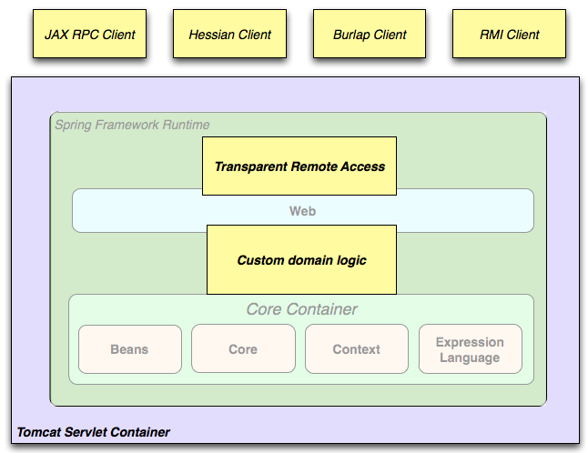
Usage Scenarios (3/3)
[11]
Notes:
viprm-integration-tool system architecture

Slide 35
Show Complete Projects
Demo Projects
Notes:
Show viprm-integration-tool
Show Sc-Scheduling
Show sample-code

Slide 36
Future Works
Basic technology instead of Spring encapsulate result
Writing a simple but completely system (view, controller, service, repository, database)
Enjoy the open source, keep contact with everyone
Notes:
Spring Boot

Slide 37
Refencnce
http://docs.spring.io/spring/docs/4.1.8.release/spring-framework-reference/htmlsingle/#overview-modules
http://docs.spring.io/spring/docs/4.1.8.release/spring-framework-reference/htmlsingle/#overview-modules
http://docs.spring.io/spring/docs/4.1.8.release/spring-framework-reference/htmlsingle/#overview-modules
http://docs.spring.io/spring/docs/4.1.8.release/spring-framework-reference/htmlsingle/#overview-modules

